Slide 1
National Center of Radiobiology and Radiation Protection
Ministry of Health
National Radon Action Plan
Assoc. prof. Kremena Ivanova, PhD
IAEA TC Project ME-RER9153- RW for Sharing the Best Practices in the Implementation of Radon Action Plan, Velingrad, Bulgaria, 09-11 April 2019

Slide 2
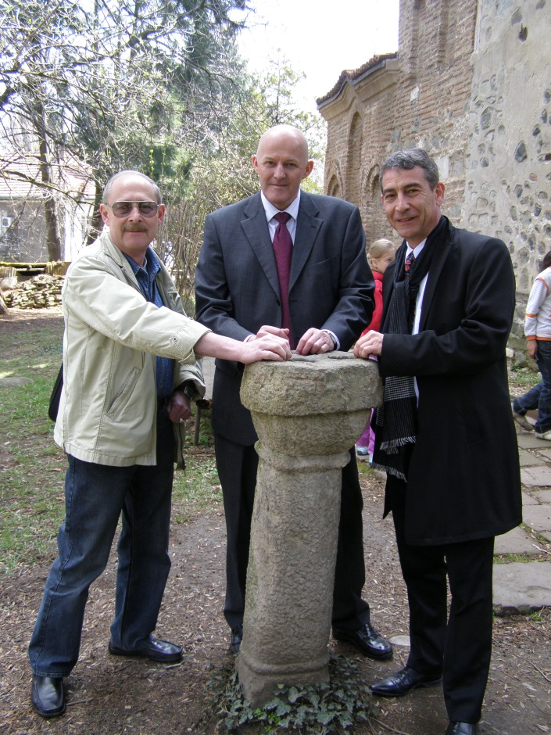
Status
National Program to reduce exposure to indoor radon (2013 – 2017) - finished
Strategy for reducing the risk of radon exposure (2018-2027) - adopted by decision of the Council of Ministers (No 55 / 01.02.2018)
National Action Plan to Reduce Risk of Radon Exposure (2018-2022) - adopted by decision of the Council of Ministers (No 55 / 01.02.2018)
IAEA TC Project ME-RER9153 RW for Sharting the Best Practices in the Implementation of Radon Action Plan, Velingrad, Bulgaria, 09-11 April 2019

Slide 3
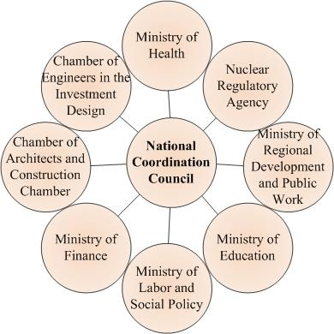
Main involved parties and coordinator
Chairman of the Coordination Council - Deputy Minister of Health
Deputy Chairman - Chief State Health Inspector
Secretary - expert from the Ministry of Health and NCRRP
National coordinator - NCRRP
IAEA TC Project ME-RER9153- RW for Sharing the Best Practices in the Implementation of Radon Action Plan, Velingrad, Bulgaria, 09-11 April 2019

Slide 4
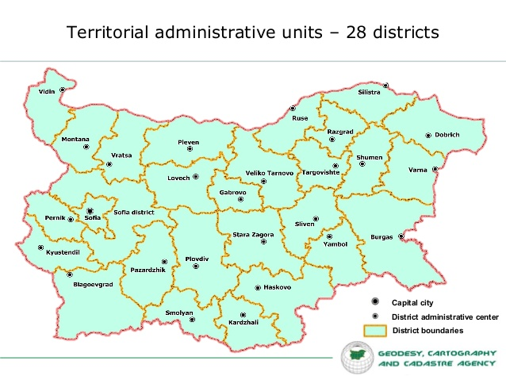
Structures and Responsibilities
Regional coordination councils - in each district under Regional health inspections.
Councils include the regional structures of the ministries and mayoralties of the district and municipalities.
Regional coordinators have a direct relationship with the National Coordination Council. Regional health inspections are the structure of the Ministry of Health.
28 Regional Coordination Councils responsible for implementation the RAP on the region.
IAEA TC Project RW for Sharing the Best Practices in the Implementation of Radon Action Plan, Velingrad, Bulgaria, 09-11 April 2019

Slide 5
Main highlights
Strategic goal - Reducing the collective and individual risk to the Bulgarian population from radon exposure in buildings by implementing a long-term policy for providing a stable legal and institutional framework and supporting the implementation of measures to reduce radon exposure.
IAEA TC Project ME-RER9153- RW for Sharing the Best Practices in the Implementation of Radon Action Plan, Velingrad, Bulgaria, 09-11 April 2019

Slide 6
Elements and targets in RAP
Operational objectives and priorities for the systematic and step-by-step implementation of the activities:
Conduct an integrated and systematic national policy aimed introduction and implementation of European and international norms, rules and recommendations in the Bulgarian legislation, as well as new scientific achievements in the field of radiation protection.
Achievement - Adopted the new Regulation of Radiation Protection base on the Council Directive 2013/59/EURATOM on 20.02.2018
IAEA TC Project ME-RER9153 - RW for Sharing the Best Practices in the Implementation of Radon Action Plan, Velingrad, Bulgaria, 09-11 April 2019

Slide 7
Elements and targets in RAP
Establish a framework for the management and implementation of national action plan with a clear structure, priorities, responsibilities, and successive steps for the long-term reduction of radon exposure.
Achievement – The National Coordination Council was established by Order of the Minister of Health on 14.05.2018.
Regional coordination councils are also set up in 2018.
IAEA TC Project ME-RER9153 - RW for Sharing the Best Practices in the Implementation of Radon Action Plan, Velingrad, Bulgaria, 09-11 April 2019

Slide 8
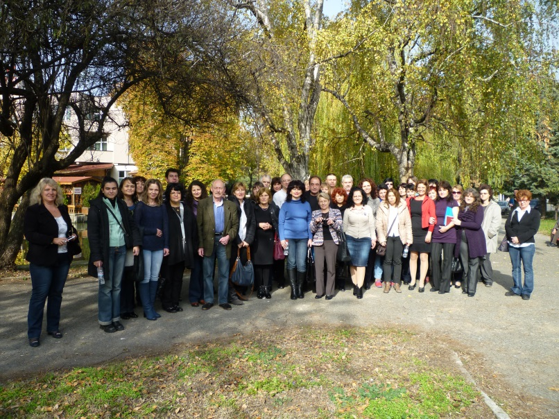
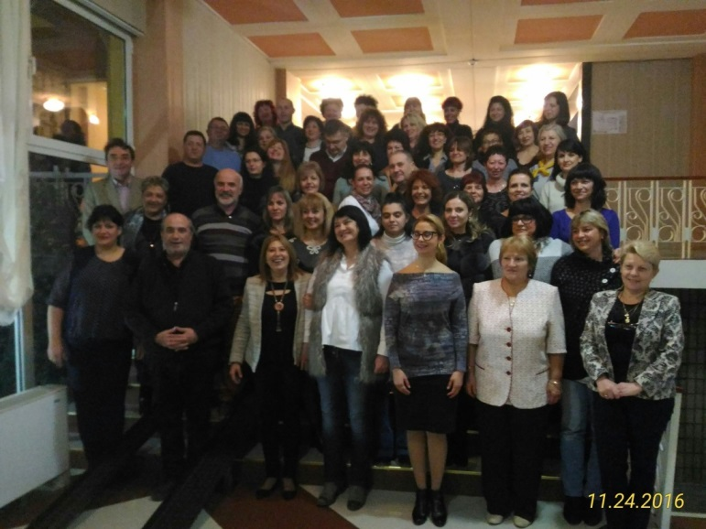
Challenges, lessons learned and good practices
Good practices:
Meetings with regional coordinators and representatives are held annually to report the achieved results and to plan for further action, as well as discussion the problems.
Conducting training seminars for regional representatives - It is important part for the successful realization of the plan's tasks.
Lessons learned - The good relationship between performers and participants of the action plan is essential for its implementation.
IAEA TC Project RW for Sharing the Best Practices in the Implementation of Radon Action Plan, Velingrad, Bulgaria, 09-11 April 2019

Slide 9
Elements and targets in RAP
Collect and systematize information on radon exposure in dwellings, public buildings and workplaces by conducting national surveys and other systematized measurements.
Establish the national data base
Radon priorities area and radon map
Other surveys of radon in soil gas, water, building materials as well as epidemiological survey
Achievement – The first national systematic survey was carried out from April 2015 to March 2016. The results were published in European Atlas and Journal:
Analysis of the spatial variation of indoor radon concentrations (national survey in Bulgaria). Environmental Science and Pollution Research, 26 (2019).
Assessment of residential radon exposure in Bulgaria. Radiation Protection Dosimetry (2018)
IAEA TC Project - RW for Sharing the Best Practices in the Implementation of Radon Action Plan, Velingrad, Bulgaria, 09-11 April 2019

Slide 10
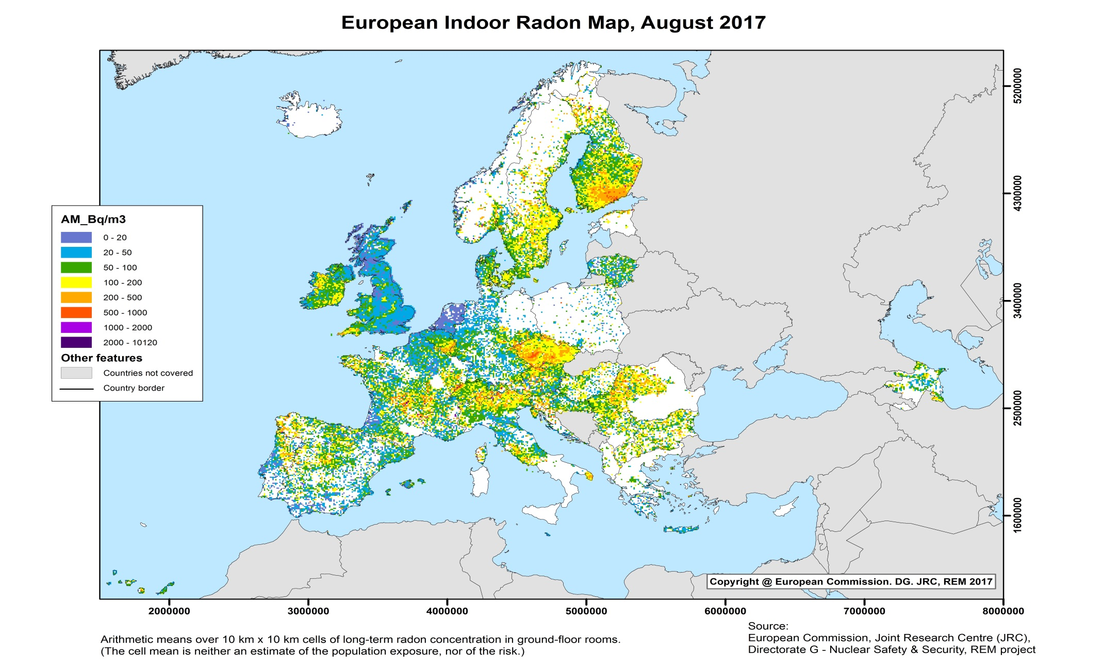
European Atlas of Natural Radiation (IWEANR 2017)
We continue doing detail indoor radon surveys by districts in the moment.

Slide 11
Challenges, lessons learned and good practices
Good practices - We are spending a time and effort for preparatory activities such as procedures, instructions, protocols and so on, as well as pilot surveys which provides better quality of the studies. This is of decisive importance for achieving the outcome of the implementation of the plan.
Challenges - Lack of money, qualified staff as well as support could complicate of implementation the plan's activities.
IAEA TC Project - RW for Sharing the Best Practices in the Implementation of Radon Action Plan, Velingrad, Bulgaria, 09-11 April 2019

Slide 12
Elements and targets in RAP
Introduction of technical rules and norms in building construction:
for the implementation of adequate preventive technical measures for new buildings
for corrective technical measures in existing buildings
Some of the activities that are in the plan:
Training the building professionals
Mechanism for conducting effective mitigation measures in public buildings including schools, kindergartens, hospitals, nursing homes and others where high levels of radon concentration are found
Achievement – A new Regulation on the technical requirements to buildings for radon protection is under the adoption. Interdepartmental discussion was during August 2018.
IAEA TC Project ME-RER9153 - RW for Sharing the Best Practices in the Implementation of Radon Action Plan, Velingrad, Bulgaria, 09-11 April 2019

Slide 13
Challenges, lessons learned and good practices
Lessons learned
One of the main activities for implementation of RAP is the preparation and adoption of a building code or an ordinance/regulation for technical requirements.
The regulation should be applicable for the country and in accordance with national specificities.
Drawing the attention of building professionals is a slow and long process. It is required a continuous efforts.
Challenges:
Lack of knowledge and understanding of the problem by building professionals
Fear of additional obligations and requirements for construction works
Uncertainty about implementation of the regulation.

Slide 14
Elements and targets in RAP
To improve public awareness for the radon health risk and opportunities for reducing.
Preparation the communication strategy, taking in account the different stakeholders, key messages and various channels.
Methodology for assessment the communication strategy.
Achievement – the logo of the national program was adapted; brochures, leaflets and other material were prepared; the webpage is maintained.
Challenges - Informing the population through press conferences and information days with the support of the Ministry of Health.
IAEA TC Project ME-RER9153- RW for Sharing the Best Practices in the Implementation of Radon Action Plan, Velingrad, Bulgaria, 09-11 April 2019

Slide 15
Elements and targets in RAP
Establishment of a monitoring system for the radon concentration in public buildings and workplaces.
Identification and classification of working place where high radon concentration are likely to be measure.
System and measures for radiation protection of workers in such working places.
Implementing activities in 2019:
Pilot survey in working place (hospital for rehabilitation).
Workshop for regional coordinators for radon in working places.
Working with Ministry of Labor and social policy and Nuclear regulatory agency.

Slide 16
Bulgarian National Radon Action Plan
objective / priority / action
expected result / indicator
responsible institution
deadline
beneficiary

Slide 17
Thank you for attention!
Благодаря за вниманието!

